Slide 1
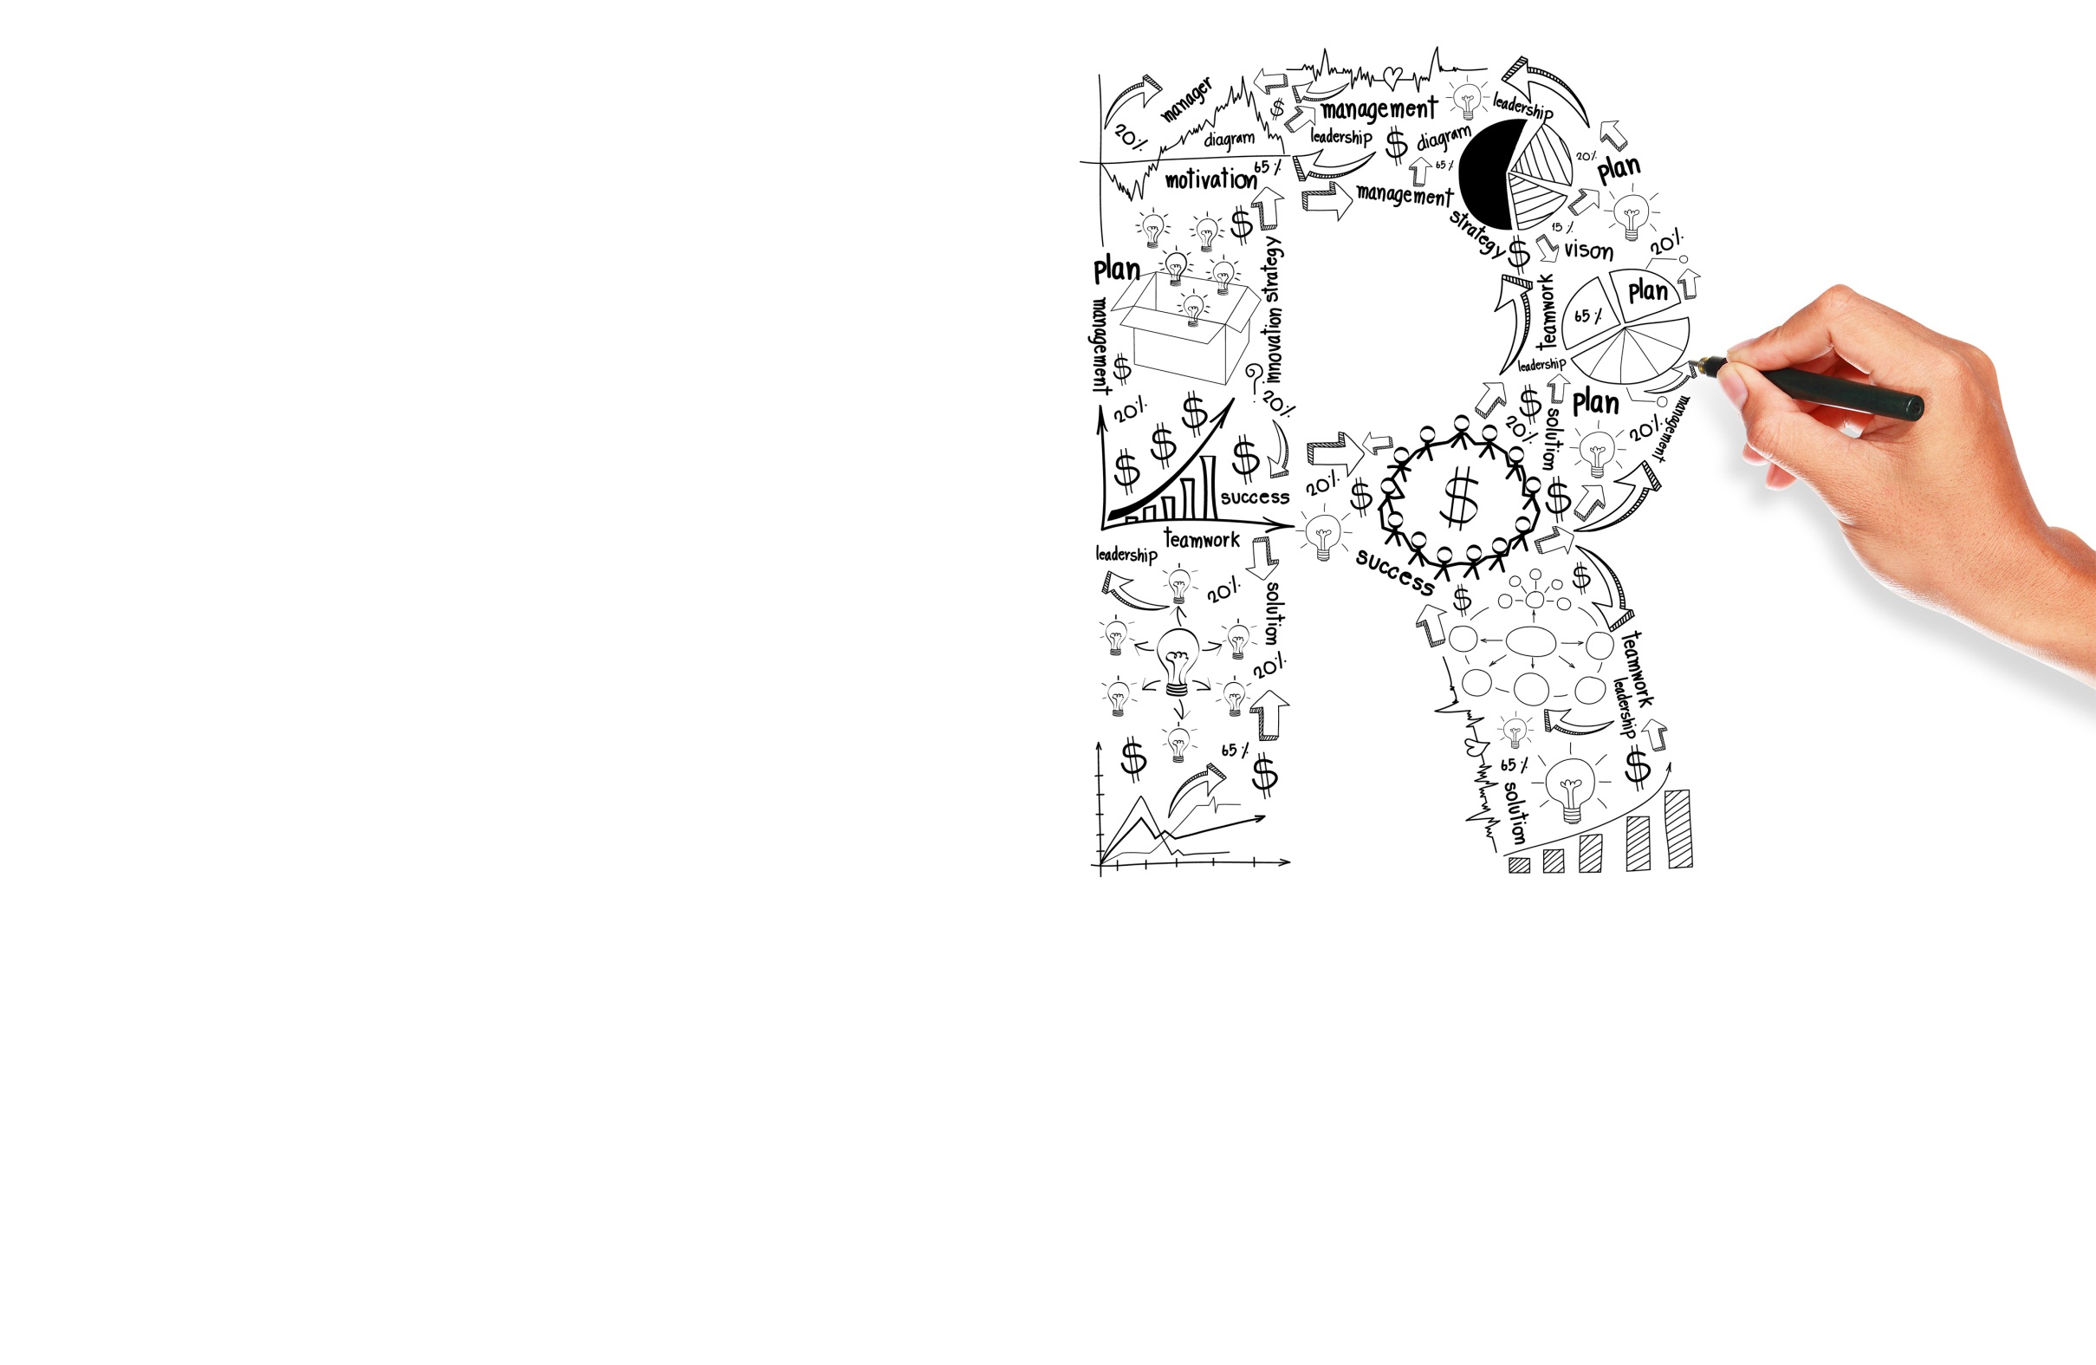


Product Listing AdsTemplate 0.02
Option 0.2
Option2

Slide 2
Steps To Follow
Check if the advertiser has
Secure checkout
Return & refund policy
Robots.txt file
Payment mode(the cards that they accept)
Contact information of the company
If these conditions are satisfied send an authorization email
Creating and Uploading the Data Feed
Google Merchant center configuration
Creating the Google Shopping Campaign in Adwords account
Google Shopping

Slide 3
Google Merchant Centre Configuration
Creating the account
Claiming & verifying the website
Linking the Google merchant center account to Adwords account
Defining tax & Shipping delivery methods

Slide 4
Creating and Uploading Data Feed
Creating the Data Feed using Google Spreadsheets,Automatic upload(scheduled fetch) ,Regular uploads by user, or using a CMS extension to generate the feed
Rectifying all the errors on the feed
Rectifying Robots.txt related restrictions
Raising a request to SQO team if the account gets suspended

Slide 5
Creating the Google Shopping Campaign in Adwords Account
Creating the Google shopping campaign in the Adwords account
Confirming that the data feed products are being displayed in the product list of the shopping campaign
After 48 hours verifying that the advertiser is getting clicks/impressions or not
When clicks/impressions are received send a congratulations mail to the advertiser.

Slide 6
Thank you!

